Slide 1
PATHWAY OPPORTUNITY PROGRAMME: Applying for the 2025 programme
Notes:
We’re here to talk about the Pathway Opportunity Programme for 2025

Slide 2
Are you interested in studying at Queen’s University?
Are you in the first year of your A-Level course or other Level 3 programme?
Would you benefit from a bit of extra encouragement and support to get to Queen’s?
THEN THE PATHWAY OPPORTUNITY PROGRAMME COULD BE FOR YOU!
Notes:
A Pathway for talented young people from NI who
Want to study at Queen’s
Are in their first year of a 2 year Level 3 Programme like A-Levels or BTEC
And could use a bit of extra encouragement and Support to get to Queen’s
Then The Pathway Opportunity Programme could be for them.

Slide 3
WIDENING PARTICIPATION:
At Queen's University Belfast, we are committed to ensuring that those well able but less likely to participate in Higher Education should have an equal opportunity to do so.
Notes:
What is Widening Participation?
At Queen's University Belfast, we are committed to ensuring that those well able but less likely to participate in Higher Education should have an equal opportunity to do so.

Slide 4
STATISTICS SHOW LOW PARTICIPATION
Parents did not attend university
Low-income households
Certain neighbourhoods
Young carers
Care experienced
Refugees/ asylum seekers/ newcomers
Queen’s works to widen participation for these groups.
Notes:
And Statistics show that we have low participation from students…
Whose parents did not attend university
From low income households
From certain neighbourhoods that don’t traditionally have students going to university
Who are young carers – for a child or an elderly parent or grandparent
Who are care experienced – either Foster Care or Residential Care
Who are refugees/Asylum Seekers/Newcomers
Queen’s works to widen participation for these groups – and the Pathway Programme is one way they do that.

Slide 5
WHAT IS THE PATHWAY OPPORTUNITY PROGRAMME?
Participants on the programme:
Get the chance to study at Queen’s
Experience and learn a bit about University life
Receive a Guaranteed Conditional Offer / Guaranteed Interview
Potentially receive a grade reduction
Events from January – December 2025 to aid progression to Queen’s in a selected subject Pathway.
Notes:
What is the Pathway programme? By participating on the programme they:
- get a chance to study at Queen’s
- experience University Life
- Receive a Guaranteed Conditional Offer or Guaranteed Interview (depending on the course)
- And potentially receive a grade reduction off their offer to Queen’s
Click
Essentially it’s a series of events from January to December of next year to aid your progression to Queen’s in a selected subject pathway. Of which there are 13 <<<leads on to the next slide.

Slide 6
WHAT SUBJECT PATHWAYS ARE ON OFFER?
Arts, Humanities and Social Sciences
Biological Sciences
Business
Computer Science
Engineering
Law
Mathematics, Physics and Chemistry
Medicine, Dentistry and Biomedical Science
Natural & Built Environment
Nursing and Midwifery
Pharmacy
Psychology
Social Work
Notes:
Read the list of 13 Pathways – that cover just about every subject at Queen’s.
And they’ll be applying to a specific Pathway on the overall Pathway Opportunity Programme and will spend about half their time on the programme within their subject Pathway and the rest of the time with the full group.

Slide 7
WHAT IS THE PATH?
Apply (By 25th October 2024)
Welcome & Orientation – January 2025
Subject Skills Session – February 2025 (Online: self-paced)
Academic Skills Session – March 2025
Subject Specific Session – April 2025
Summer School – Late June or Early July 2025
Next Steps Session – September 2025
Celebration Event – December 2025
University Information Session – June 2025
Notes:
“So what is the path?”
Each box comes up with a click to talk the students through the steps:
Apply by 25 october (applications open on 30th September)
Welcome event on campus in January and a first chance to meet the academics and lecturers from their Pathway subject
Online subject skills sessions (specific to their pathway) on the VLE over the February mid-term break to get them started in their subject – 4-5 hours work online
Back to campus in March for Academic Skills such as study skills and exam preparation
A day on campus in April to work with their subject academics.
Then after they’ve done their AS exams, another day on campus in June for the University Information Session to learn more about University but also to get ready for the summer residential…
Week-long on campus residential summer school in either June or July (depending on their Pathway) where they work in their subjects and complete an academic assessment
Return in September for an on campus Next Steps session to focus on their next steps with their UCAS application
Finish off in November/December 2025 with an on campus Celebration event where you come down on a Saturday with your family for a graduation of sorts to celebrate completing the programme

Slide 8
WHAT ARE THE BENEFITS?
Guaranteed Conditional Offer / Guaranteed Interview
Up to a 2 A-Level grade reduction *
£1000 Kilwaughter Minerals Bursary
UCAS advice
Experience university life
Tailored support upon arriving at Queen’s
* Depending on performance on the programme and course applied for
Notes:
Benefits:
Receive a guaranteed conditional offer of a place at Queen’s University within your Pathway subject, or a guaranteed interview for courses that have interviews (Medicine, Dentistry, Pharmacy, Social Work and Nursing & Midwifery)
Be eligible for an offer reduced by up to two A-Level grades (depending on performance and course applied for). Explain that a 2 grade reduction will take a standard offer for Law of AAA down to ABB and will take a standard offer of ABB for History down to BBC.
Receive a £1000 support bursary upon 1st year entry at Queen’s – provided by Kilwaughter Minerals, a major supporter of the Pathway programme since it started in 2017
Receive UCAS Application Advice – you’ll hear from the lady at Queen’s who reads your UCAS applications
Experience a bit of University Life
Receive tailored support upon arriving at Queen’s, to help them get settled in when they arrive and to be there to support them, as Pathway Students, through their time at Queen’s

Slide 9
AS A SUMMARY:
6 x 1-day events
1 x Self-paced online coursework (February)
5 day Summer School
Notes:
So to summarise:
The programme is made up of
- 6 one day events
- 1 bit of Self Paced online coursework in February (about 4-5 hours work)
- the 5 day summer school

Slide 10
THE PATHWAY SUMMER SCHOOL

Slide 11
THE SUMMER SCHOOL
Last week of June or First week of July (depending on Pathway)
Monday to Friday
Meet your fellow Pathway students
Experience studying like an undergraduate
Attend lectures from your subject’s top academics
Work on group projects with current undergraduate students
Complete Assessed Coursework
Notes:
Describe the residential.
In either the last week of June or the first week of July – depending on your Pathway. You arrive on Monday morning to get registered and then straight to your lecture halls, laboratories, and mock courtrooms. That evening you enjoy dinner and then off to get settled into your room and then bed. Tuesday morning you’re back down to campus and this repeats until Friday morning when you go down to the University to complete your assessment. And then you head home on Friday afternoon.
You will meet your fellow Pathway students, experience studying like an undergraduate, attend lectures from top academics and work on group projects with current undergraduate student assistants.
And then on Friday you complete the Assessed coursework which I’ll describe in a moment

Slide 12
SUMMER RESIDENTIAL
Staying at Elms Village
Individual en-suite room
10 students per floor
15 mins walk to campus
All inclusive: Meals Social Activities Academic Sessions Employer Engagement
Notes:
You’ll be staying at our halls of residence – Elms Village
You’ll be staying in ensuite rooms – which means you’ll have your own bathroom and shower
10 students per floor – with a Student Guide on each floor – that’s a University Student who’ll be there to look after you but also a good person to find out about University
15 minute walk to campus –
It’s all-inclusive so everything is provided – meals, social activities in the evening, academic sessions and employer engagement sessions

Slide 13
SUMMER SCHOOL ASSESSMENT
A guaranteed conditional offer / guaranteed interview from Queen’s
1 grade reduction: 50 – 64% in the Assessment
2 Grade reduction –65% or above in the Assessment *
* For Medicine, Dentistry, Pharmacy, Biochemistry, Nursing, Midwifery and Social Work: Maximum one grade reduction.
Notes:
Focussing on the assessment that will be completed during the summer school
The Assessment is different for every Pathway and it could include various elements like learning diaries, multiple choice tests, group project or presentation, essay, computer programme, etc.
Everyone who completes the programme will get the guaranteed conditional offer or guaranteed interview
If they score 50-64% they will also get a 1 grade reduction off their offer.
And if they score 65% or above they get a 2 grade reduction off their offer.
Again please note that there are special conditions for those applying to Medicine, Dentistry, Pharmacy, Biochemistry, Nursing, Midwiferyand Social Work where there’s a maximum of a 1 grade reduction.

Slide 14
WHAT IS REQUIRED FROM ME TO SUCCESSFULLY COMPLETE THE PROGRAMME?
Attend all events
Complete all Online coursework
Complete the Residential Summer School
Notes:
Read slide

Slide 15
THE PATHWAYS
Notes:
Let’s talk about the 13 Pathways

Slide 16
WHAT COURSES ARE AVAILABLE ON THE PATHWAY?
Notes:
Here are some of the courses available to you on the AHSS pathway.
Because the Pathway is multidisciplinary your work on the Pathway Programme will incorporate some, but not all of the above course. For example you probably won’t do any Criminology coursework on the Pathway but that subject is available to you when you come to Queen’s.

Slide 17
WHICH COURSES ARE AVAILABLE ON THE PATHWAY?
Notes:
These are the courses you can study from the BioSci pathway

Slide 18
WHICH COURSES ARE AVAILABLE ON THE PATHWAY?
Notes:
These are the courses available, with a number of variations including languages and placement years.

Slide 19
WHICH COURSES ARE AVAILABLE ON THE PATHWAY?
Notes:
Tell them the courses available.

Slide 20
WHICH COURSES ARE AVAILABLE ON THE PATHWAY?
Notes:
On the Engineering Pathway you’ll study 4 main branches of Engineering:
Civil Engineering
Chemical Engineering
Electrical and Electronic Engineering
Mechancial Engineering
Everyone does all 4 and are assessed on all 4. And then all these courses are available with other combinations available, including placement year options.

Slide 21
WHICH COURSES ARE AVAILABLE ON THE PATHWAY?
Notes:
Tell them the courses available.

Slide 22
WHICH COURSES ARE AVAILABLE ON THE PATHWAY?
Notes:
Tell them the courses available in the Maths, Physics and Chemistry Pathway

Slide 23
WHICH COURSES ARE AVAILABLE ON THE PATHWAY?
Notes:
Courses available in MDBS – mention the exceptions about Medicine and Dentistry again

Slide 24
WHICH COURSES ARE AVAILABLE ON THE PATHWAY?
Notes:
Tell them there are also language options and other courses available and to check the ‘available courses’ list

Slide 25
WHICH COURSES ARE AVAILABLE ON THE PATHWAY?
Notes:
Courses available in Nursing and Midwifery and there are options to start in September 2026 or push it back to start in February 2027.

Slide 26
WHICH COURSES ARE AVAILABLE ON THE PATHWAY?
Notes:
Courses available in Pharmacy – remember to mention the 1 grade in Mpharm and it has a Guaranteed Interview, not guaranteed conditional offer like the other two Pharmaceutical courses

Slide 27
WHICH COURSES ARE AVAILABLE ON THE PATHWAY?
Notes:
The only course available in the Psychology Pathway, but if that’s what you’re interested in then this is the right Pathway for you.

Slide 28
WHICH COURSES ARE AVAILABLE ON THE PATHWAY?
Notes:
Courses available in Social Work – remember to mention about how there will be no guaranteed offer but instead a guaranteed interview but that they can receive up to one grade reduction if successful at interview

Slide 29
HOW DO I PICK A COURSE?
www.qub.ac.uk/courses/
Google: “Queen’s University Belfast Course Finder”
Notes:
Students can research all the courses at Queen’s by going to the Queen’s Course Finder at this link or google: “Queen’s University Belfast Course Finder”

Slide 30
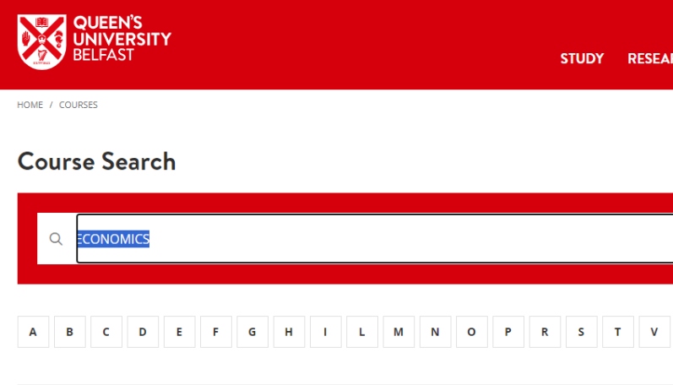
VISIT OUR COURSE FINDER https://www.qub.ac.uk/courses/
Find out more about the Pathway courses on offer
Check that you meet any individual course requirements for your chosen Pathway subject prior to your application
Economics
Notes:
The web address takes you here where you can type in the course code or course name. Here I’ve entered “economics”

Slide 31
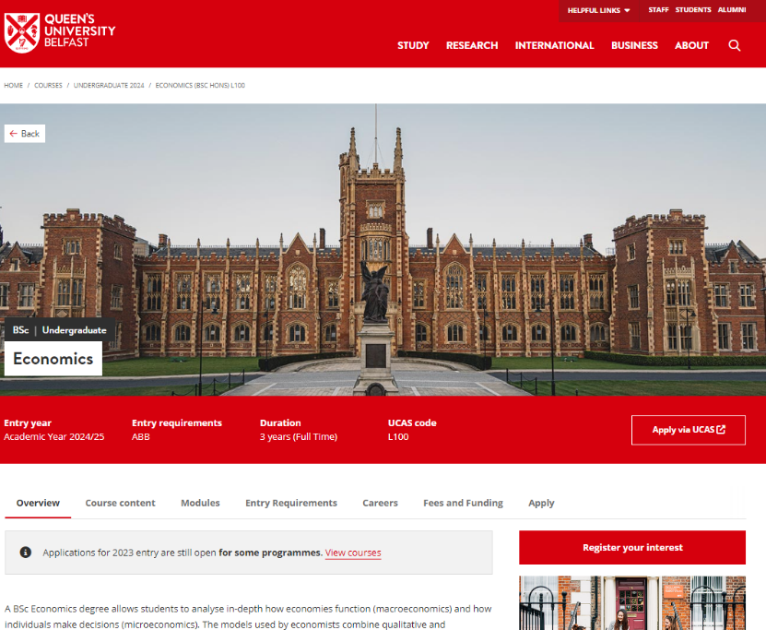
Notes:
It’ll show you all sorts of information about the course (an overview, the course content, the entry requirements and career prospects), but I especially need you to go to Entry Requirements (tell them click on the circled link)

Slide 32
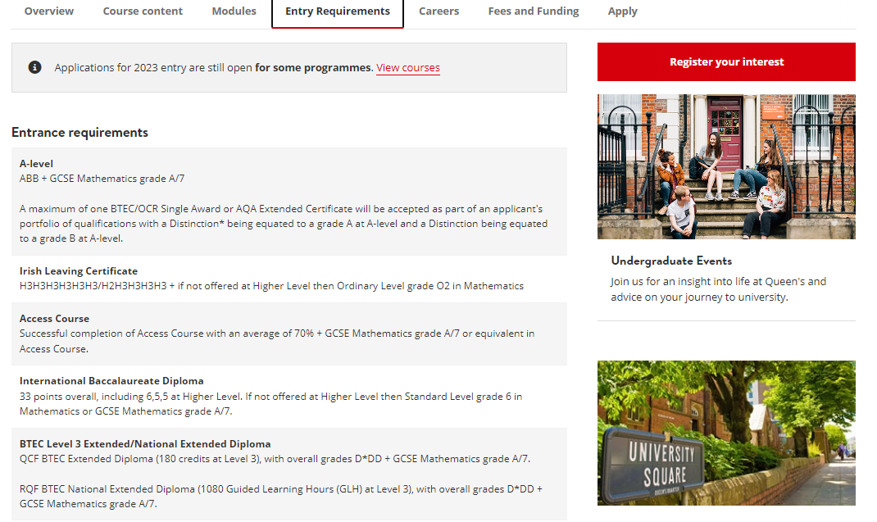
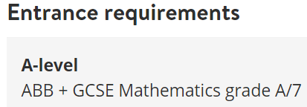
Notes:
And focus on the entry requirements. (click to zoom in) Here the requirement is ABB but doesn’t list any specific subjects so any 3 A-Levels will work. But for GCSE’s in this course you must have an A in Maths GCSE. If you have a B you may be able to do Business Management or Accounting but not Economics.
And as we discussed before, with the grade reduction this could be reduced to BBB or even BBC (but you still need the A in GCSE Maths)

Slide 33
ELIGIBILITY REQUIREMENTS
Notes:
What is required to be eligible to apply?

Slide 34
Section A Criteria
You must meet all of the following:
● You must be ordinarily resident in Northern Ireland and be in full-time attendance at a school or college in Northern Ireland.
● You must currently be in year 1 of an acceptable (to the University) two-year Level 3 qualification such as A-Levels, BTEC etc.
● Neither of your parents have attended university nor obtained an undergraduate degree (or equivalent) in the UK, Ireland or abroad.
● You must have at least 6 GCSEs (or equivalent) at grades A*-C, including English Language, of which 5 must be at grade B or above.
Notes:
You must meet ALL of the Section A criteria.
You must be ordinarily resident in Northern Ireland and in full time education here.
You must be in year 1 of a two year level 3 programme – like A-Levels or BTEC’s
the Neither Parents one – say “but if your parents are currently studying at University or have graduated only within the last 5 years, then you can still click this one”
And you must have 6 GCSE’s at A* to C and we can include ONE non-GCSE like a BTEC in that, and that includes English GCSE. Plus of those you must have 5 at B or above. So that can be BBBBB, but with averaging we’ll also accept “ABBBC” and “AABCC”. Please note that C*’s do NOT count as B’s for this criteria.

Slide 35
Acceptable Level 3 Qualifications
A-Level
A-Level
A-Level
A-Level
A-Level
BTEC Subsidiary Diploma (or other single award)
Notes:
What level 3 qualifications are acceptable to Queen’s?
Three A Levels are fully acceptable
Click
And two A-Levels and one BTEC Subsidiary Diploma or other Single Award qualification like OCR’s are acceptable.
Click to next slide

Slide 36
Acceptable Level 3 Qualifications
BTEC Extended Diploma
(Triple Award)
BTEC Diploma
(Double Award)
A-Level
BTEC Diploma
(Double Award)
BTEC Subsidiary Diploma (or other single award)
Notes:
And at the other end of the spectrum a BTEC Extended diploma worth 3 A-levels is acceptable – but is generally only taught at regional colleges, not at schools
Click
And if your school does BTEC Diplomas which are worth 2 A-levels then that’s fine with an A-Level OR
Click
Another single award BTEC or OCR
Click to next slide

Slide 37
Not Acceptable
A-Level
BTEC Subsidiary Diploma (or other single award)
BTEC Subsidiary Diploma (or other single award)
BTEC Subsidiary Diploma (or other single award)
BTEC Subsidiary Diploma (or other single award)
BTEC Subsidiary Diploma (or other single award)
Notes:
What is unfortunately not acceptable to get on the Pathway Programme nor to come to Queen’s at all is
A single A-level and TWO Single Award BTEC’s or OCRS
Or indeed three single award BTEC’s or OCR’s

Slide 38
Section B Widening Participation Criteria
You must meet ONE of the following:
Be eligible for or are currently receiving free school meals (FSM) and/or Education Maintenance Allowance (EMA).
Be the main carer for a family member or dependant.
Have a permanent residence postcode that is classified as being in a "disadvantaged neighbourhood” by the Northern Ireland Statistics and Research Agency.
Be a Newcomer, a Refugee or an Asylum Seeker.
If you are care experienced or currently in the care of a Health and Social Care Trust, you are automatically offered a place on the programme provided you meet the requirements of Section A: Northern Ireland resident, 1st year of a 2 year Level 3 programme and GCSE (or equivalent) grades.
ON YOUR APPLICATION FORM PLEASE SELECT ALL SECTION B CRITERIA THAT APPLY TO YOU.
Notes:
They must meet just ONE of these Section B criteria
For postcode say “by the Northern Ireland Statistics Research Agency” and this looks at a number of things like how close hospitals and leisure centres are to the post code, availability of buses and doctors offices as well as looking at average incomes.”
Highlight the note at the bottom to tick ALL that apply because the applications are initially shortlisted based on the different Section B categories that apply to them so the more they tick the higher they will be on the shortlist.

Slide 39
APPLYING?
We expect about 500 applications for 300 places on the programme: 20-30 places in each of the 13 Pathways.
go.QUB.ac.uk/QUBPathway
Or Google “Queen’s University Belfast Pathway”
Notes:
So now for applying?
We expect 500 applications for 300 places so you do have a pretty good chance of getting on the programme
Go to this web site or just Google “Queen’s University Belfast Pathway”

Slide 40
APPLICATIONS OPEN Monday 30th September 2024
Notes:
Applications open (or did open) on 30th September 2024

Slide 41
2025
Notes:
“The web link takes you to this web page. The first part is the instructions in the red part.
To check your postcode, download the Postcode Checker 2025 in the Media Section of the web site and use Ctrl+F to search for your postcode (with the space in the middle). If it says “Meets Postcode Criteria” then they meet the Postcode criteria in Section B. If it says “Does not meet Criteria” then they don’t meet it.
Then tell them to apply by clicking the “THE ONLINE APPLICATION IS AVAILABLE HERE!”.

Slide 42
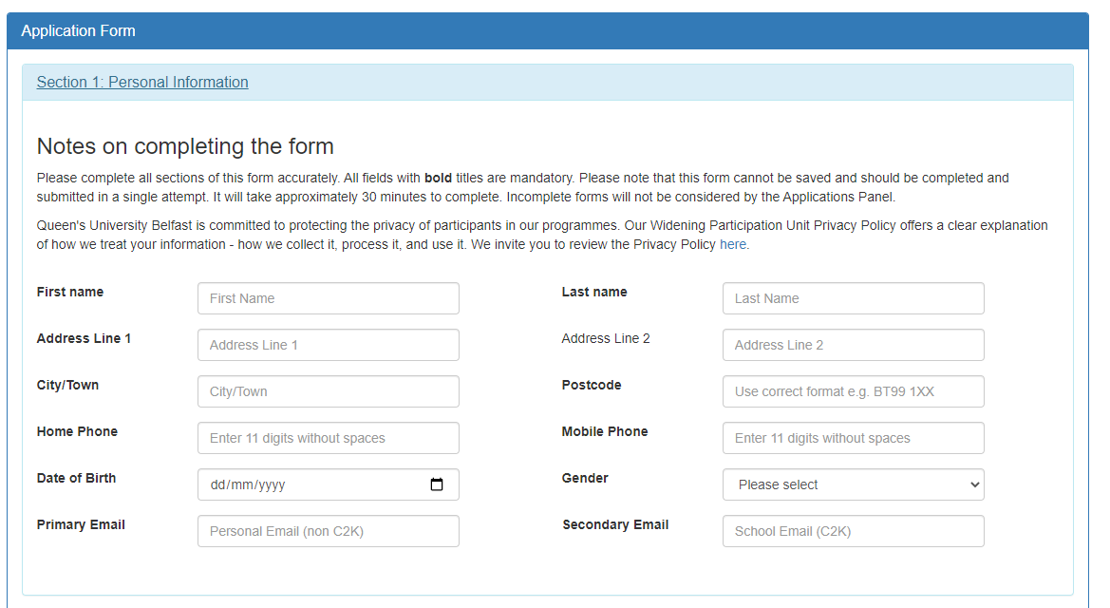
1. Personal Information
Note: Application cannot be saved!
Notes:
The application is online and looks like this. There are 7 areas to fill in starting with Personal Information.
Note: the application cannot be saved so students should read through it, collect all required information and write the personal statements on Microsoft WORD and then complete the application cutting/pasting the statements in from MS WORD.

Slide 43
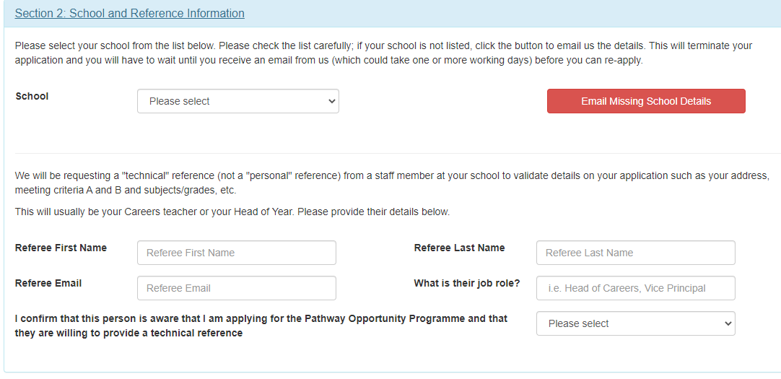
2. School / Reference
Note: Technical Reference not Personal Reference
Notes:
They select their school from the drop down list and then give us a teacher who will provide their reference
Note that the reference is a “Technical” Reference not a personal reference.
Most likely their careers teacher or head of year.

Slide 44
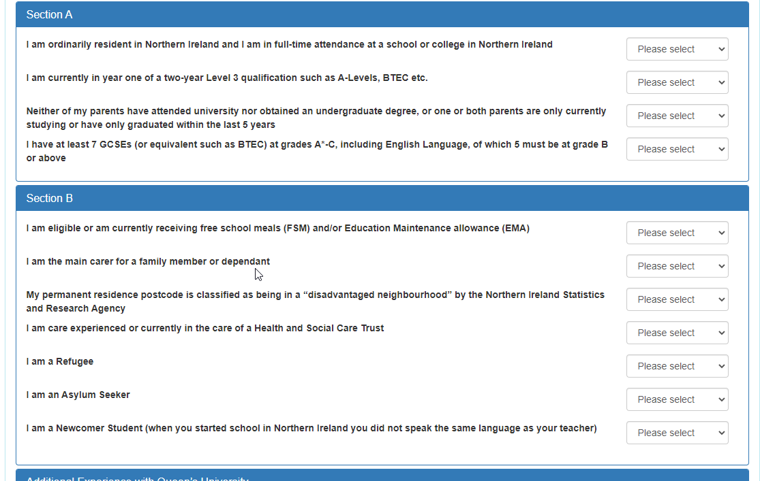
3. Eligibility
Section A and Section B Criteria
Notes:
Where they tick the Section A and Section B criteria that apply to them

Slide 45
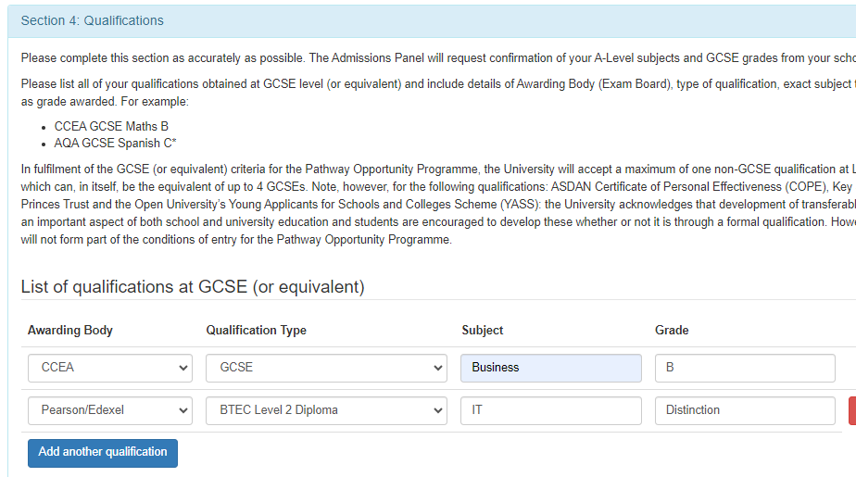
4. Qualifications
From Drop Down Boxes:
CCEA GCSE Business B
WJEC A-Level Sociology General
Pearson/Edexcel BTEC Subsidiary Diploma Travel & Tourism
Notes:
For Qualifications they’ll put in their GCSE subjects and grades and A-levels. They are entered using the drop down boxes.
Normally students applying to the Pathway Programme will NOT have completed AS or A2 A-Level exams, however if you have completed any, already, then there’s a box to list the qualifications, when you completed them and what grade you received.

Slide 46
5. Pathway Selection
Primary Pathway
Secondary Pathway (if desired)
Notes:
Select one pathway, but if there is a second they’d definitely be interested in if the first one is over subscribed they can select a secondary Pathway

Slide 47
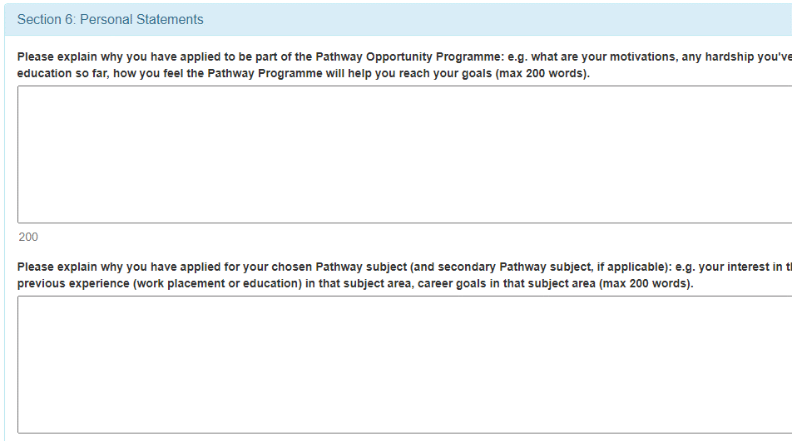
6. Personal Statements
Max 200 words each
Please explain why you have applied to be part of the Pathway Opportunity Programme: e.g. what are your motivations, any hardship you've experienced in your education so far, how you feel the Pathway Programme will help you reach your goals (max 200 words).
Please explain why you have applied for your chosen Pathway subject (and secondary Pathway subject, if applicable): e.g. your interest in that subject, any previous experience (work placement or education) in that subject area, career goals in that subject area (max 200 words).
Notes:
Personal statement is just two small paragraphs (200 words each)
The first one about why they want to be on the programme
And the second one about why we should consider you for your chosen Pathway

Slide 48
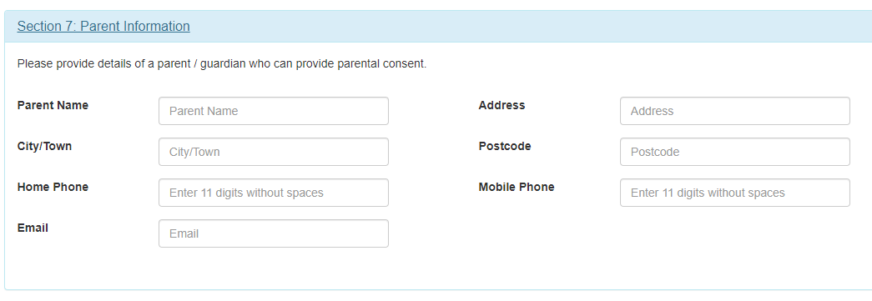
7. Parents’ Information
Contact Details
Notes:
Parents contact information

Slide 49
When all complete and checked hit “Check and Submit Application”
Notes:
When all complete and checked – hit submit. The system will run a check of the application and ask you to fix them before the submission will be allowed.
If the student realises they need to change something AFTER they have submitted, they just need to email pop@qub.ac.uk and let us know and we’ll manually change the applications record.

Slide 50
So…

Slide 51
If you…
Want to study at Queen’s University Belfast
Meet the eligibility criteria (Section A and one from Section B)
Want to receive a Guaranteed Conditional Offer / Guaranteed Interview to Queen’s
Want an opportunity to receive up to a 2 grade reduction in your offer.
Want a £1000 bursary from Kilwaughter Minerals in your first year at Queen’s
Experience university life, make new friends, enjoy some challenges
THEN APPLY NOW!
Notes:
Read out each point and
Click
Then apply now – applications open on 30th September 2024
Click

Slide 52
APPLICATION DEADLINE
Friday 25th October 2024
Notes:
And get the application in by Friday 25th October – just before the Halloween break..

Slide 53
QUESTIONS?
Go online:
go.qub.ac.uk/QUBPathway
Telephone: 028 9097 5020
Email: pop@qub.ac.uk
Notes:
Any Questions.

